Slide 1
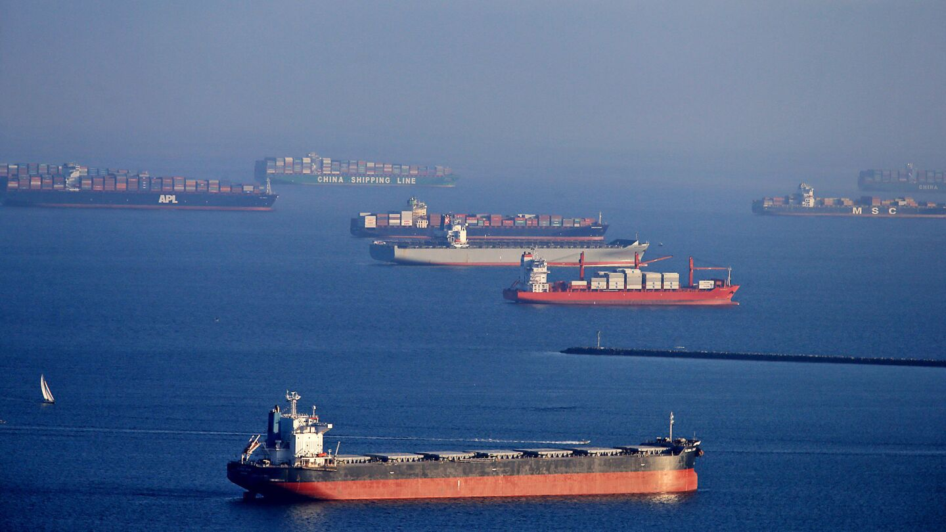
COVID-19 vs. Air Quality
The Unexpected Correlation between Lockdowns and Air Quality

Slide 2
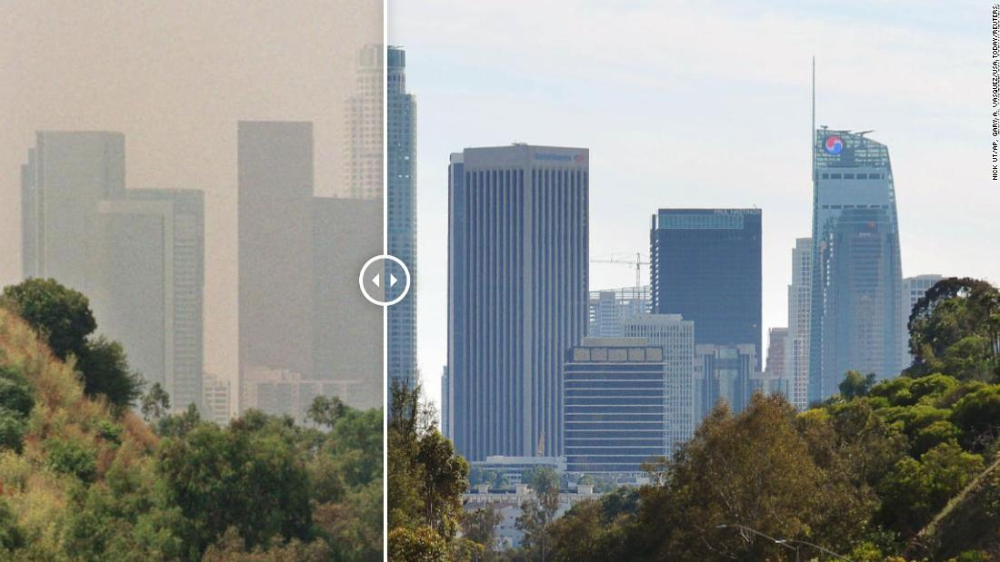
Our Question:
How did the COVID 19 lockdowns influence Air Quality (AQI) throughout the United States?

Slide 3
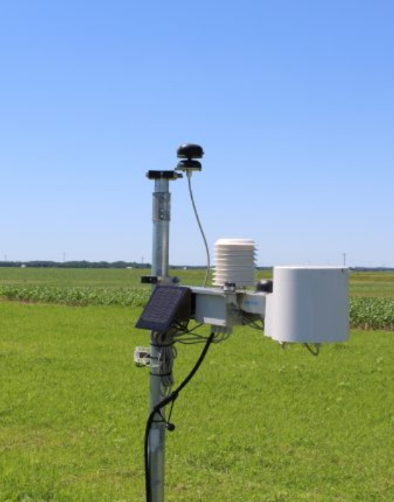
What is AQI?
Air Quality Index
A numerical scale ranging 0-500 ppm that measures the quality of air in a specific location, and how it may affect human health
Measures the concentration of six major air pollutants
Ground-level ozone
Particle pollution
Carbon monoxide
Sulfur dioxide
Nitrogen Dioxide.
Can change from day to day or hour to hour
Major sources of pollution include:
Transportation
Power Plants
Industrial Facilities
Agriculture
AQI monitoring station ^

Slide 4
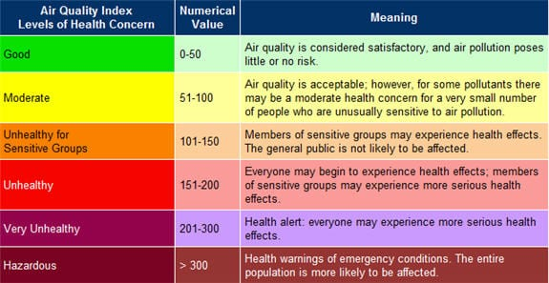
What do AQI Measurements Mean?

Slide 5
Executive Summary and Overview
Source monthly AQI data from 2019-2021 for 3 different US cities with varying population levels
Los Angeles, California (Pop. 3.8 Million)
St, Louis, Missouri (Pop 280,000)
Jeaneu, Alaska (Pop 31,500)
By sourcing cities with different population levels and geographical regions, we hope to get a more definitive picture of the data
How did the AQI change in each city from 2019-2021?
6 months before pandemic declaration (March 11th, 2020)
6 months during pandemic declaration
6-12 months after pandemic exploration
Hypothesis: Overall Air Quality would increase due to less commerce, driving, etc.

Slide 6
Data Collection/ Demo

Slide 7
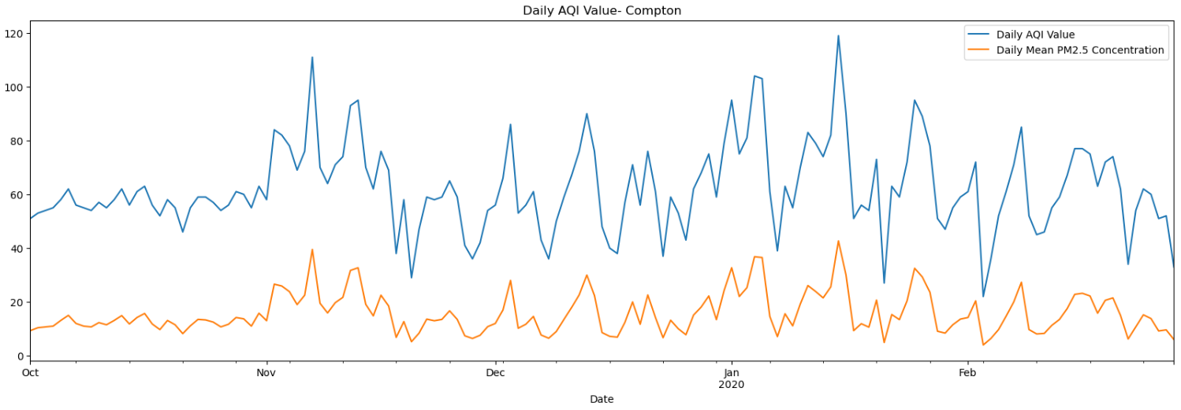
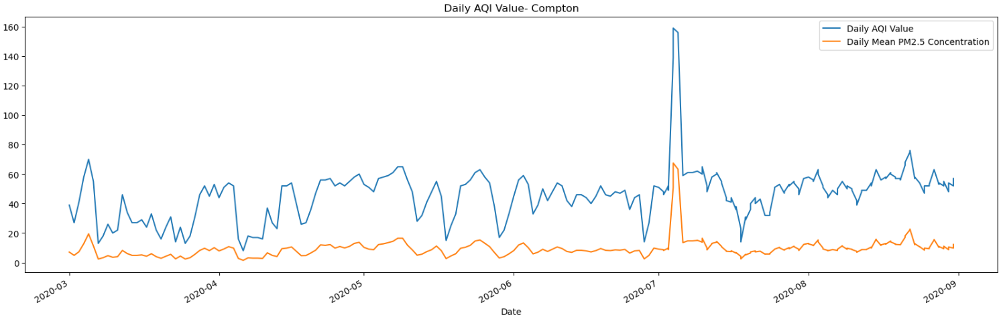
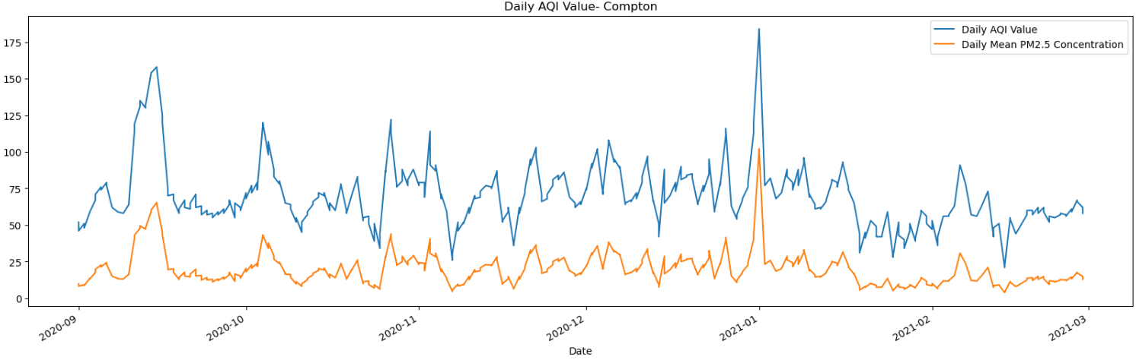
Los Angeles
AQI Index 6 months before pandemic declaration:
AQI Index during pandemic declaration:
AQI Index 6 months post pandemic declaration:

Slide 8
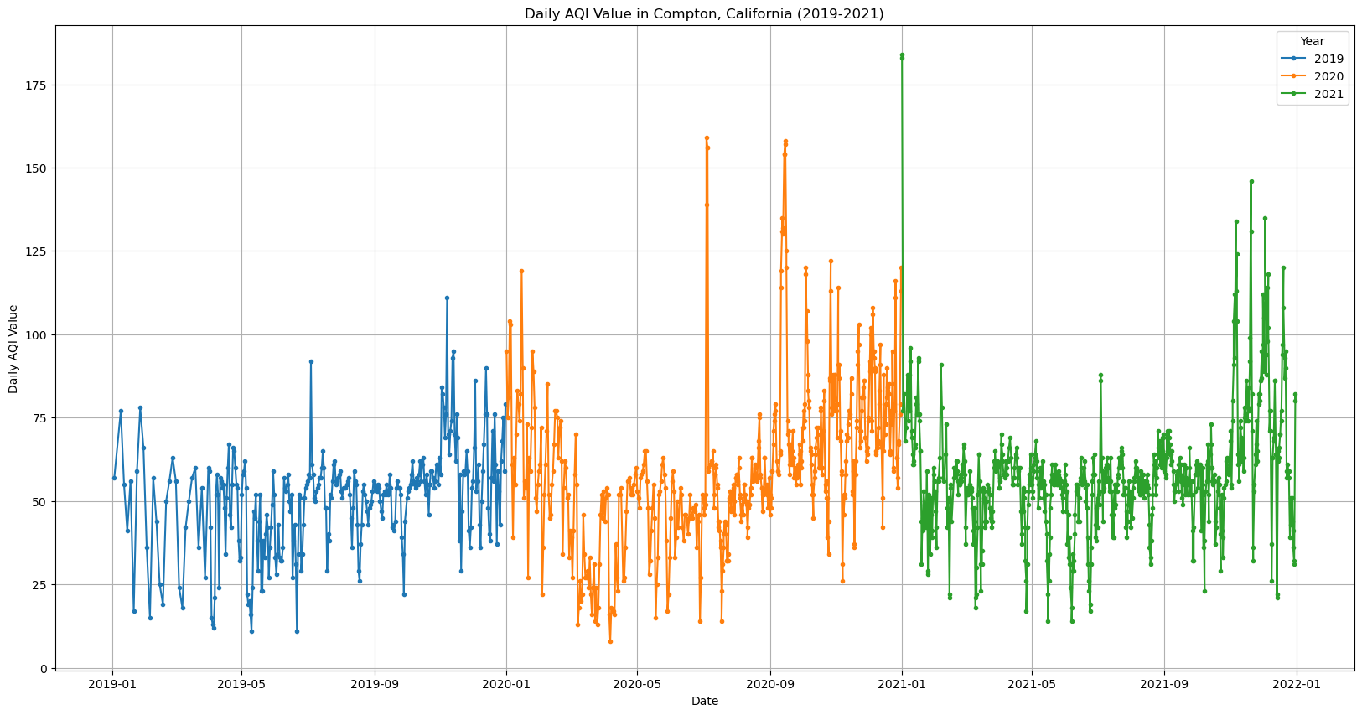
Los Angeles

Slide 9
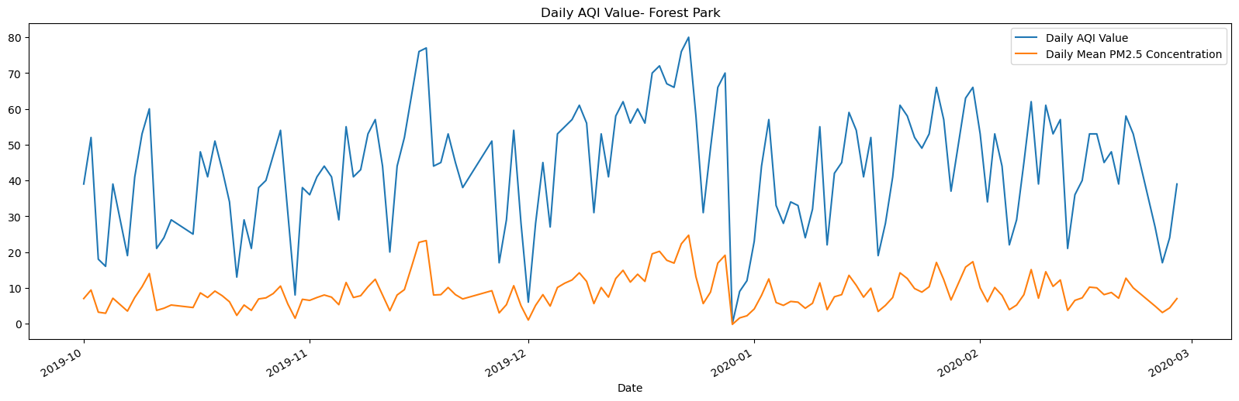
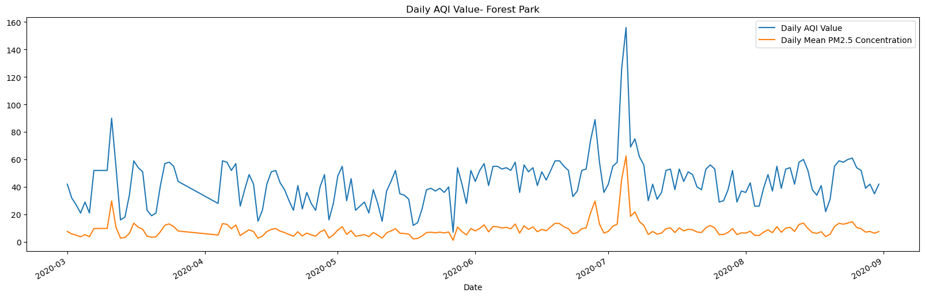
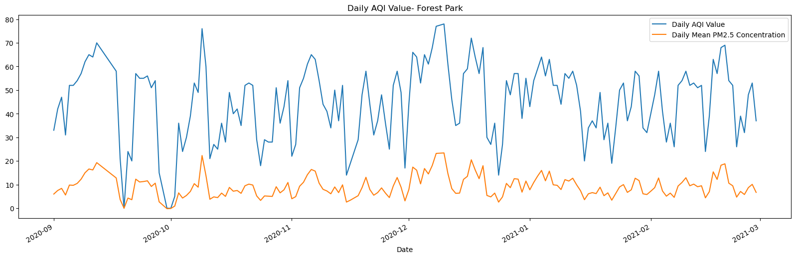
St. Louis
AQI Index 6 months before pandemic declaration
AQI Index during pandemic declaration
AQI Index 6 months post pandemic declaration

Slide 10
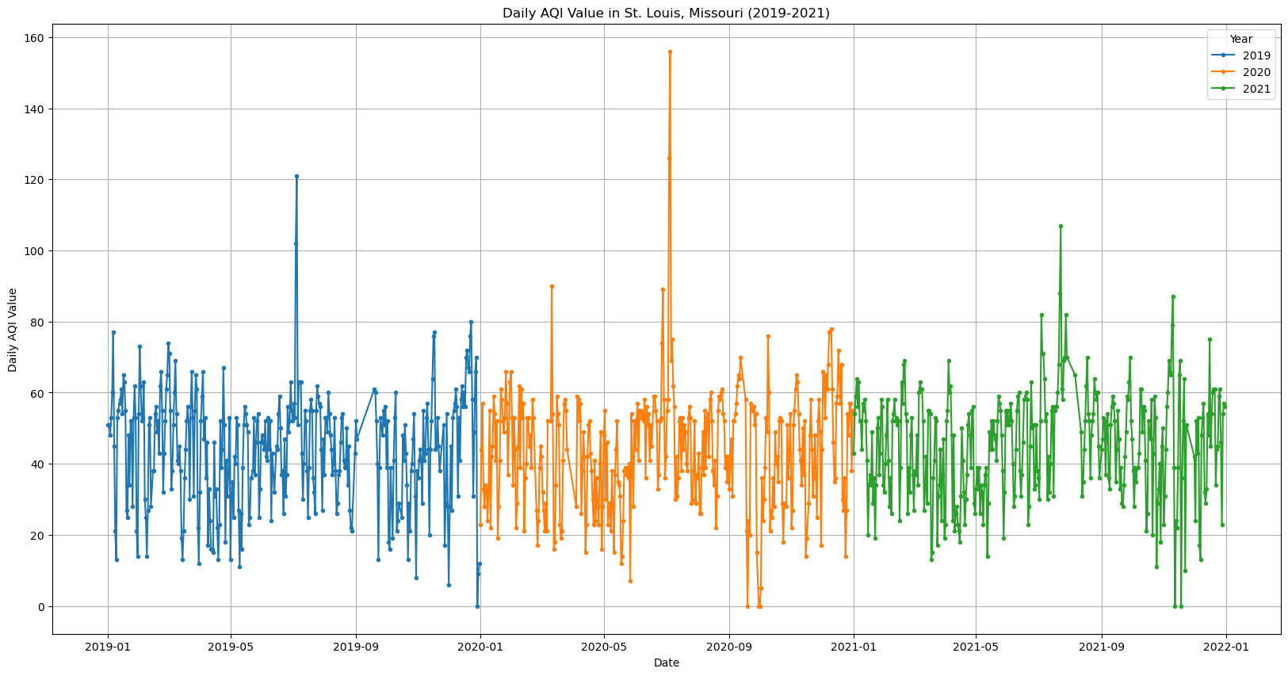
St. Louis

Slide 11
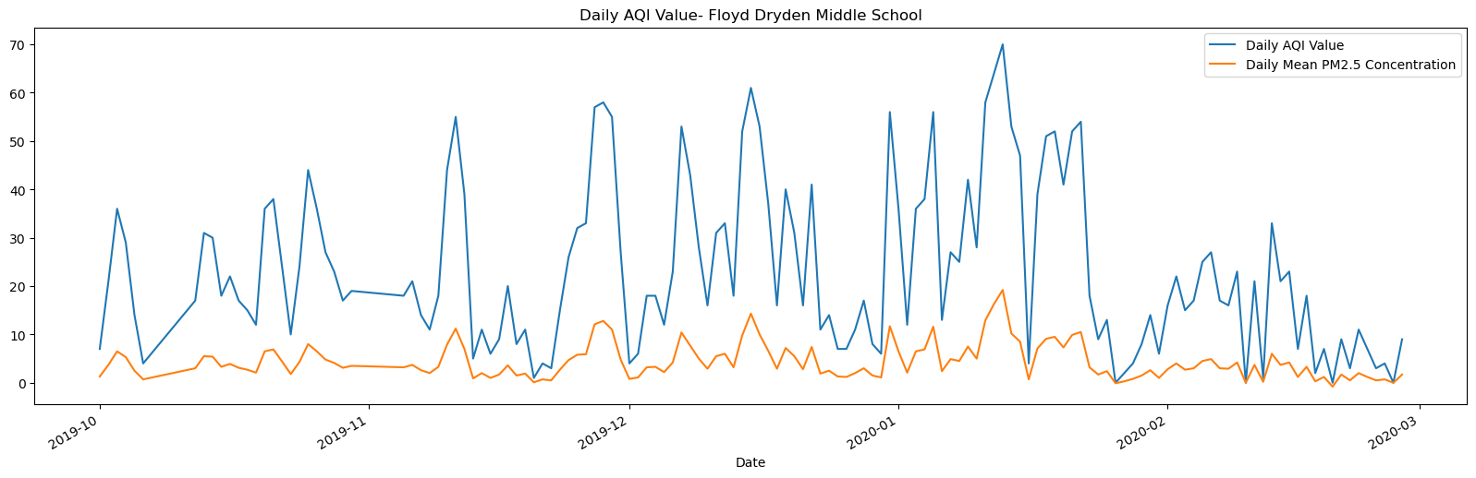
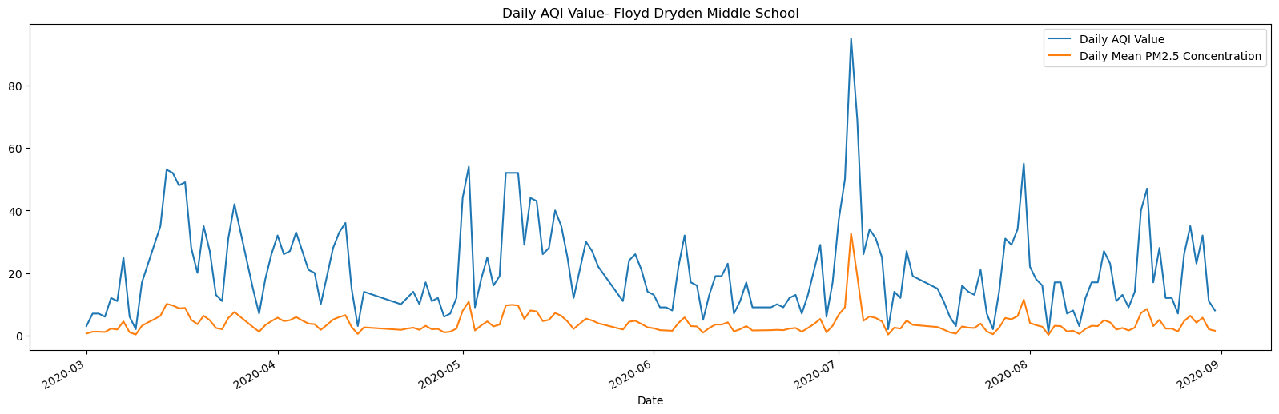
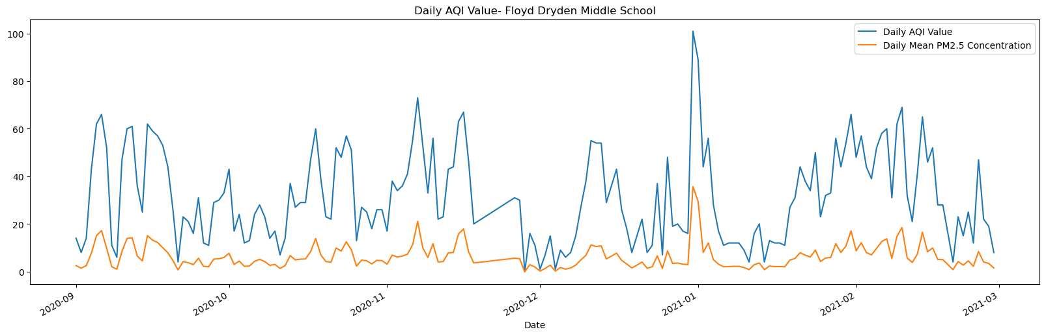
Jeaneu
AQI Index 6 months before pandemic declaration
AQI Index during pandemic declaration
AQI Index 6 months post pandemic declaration

Slide 12
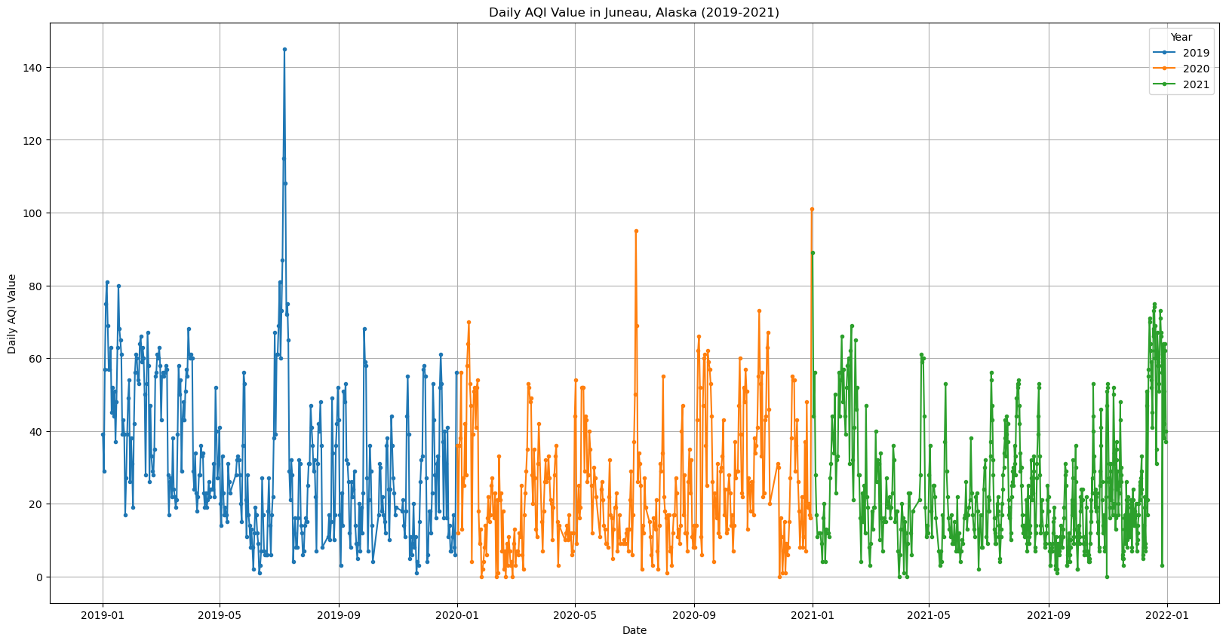
Jeaneu

Slide 13
Findings
Not a strong correlation between AQI and lockdowns
The overall summertime spike in AQI was due to extraneous factors
Statistics show AQI has always increased during the summers
Pollen?
Uptick in travel?
Weather Patterns?
Further study is needed to determine why exactly AQI increases so highly during summertime months in the United States.

Slide 14
QUESTIONS?

Slide 15
Citations for the presentation
(Slide 3 graphic source):
https://bazallergy.com/understand-the-basics-of-the-air-quality-index/
(Slide 3 information source):
https://www.healthpartners.com/blog/air-quality-index/#:~:text=Poor%20air%20quality%20is%20polluted,of%20smoke%2C%20soot%20and%20smog.
(Slide 2 graphic source):
https://edition.cnn.com/2020/04/07/us/los-angeles-pollution-clean-air-coronavirus-trnd/index.html
(Slide 1 graphic source):
https://www.latimes.com/la-fi-port-container-ships-pg-photogallery.html

